Slide 1
How can Big Mountain Resort recoup their higher operating costs of $1.54 million and retain or increase their previous year’s profit for this upcoming year?

Slide 2
Problem to Resolve
Big Mountain Resort, a ski resort that accommodates skiers and snowboarders of all levels has recently added new equipment to the resort resulting in a higher operating cost. The operating costs has increased by $1,540,000 due to the addition of the new chair. The resort now needs to find a way to increase profit either by cutting costs or increasing ticket value to combat this cost increase.
The resort has previously priced their tickets by charging a premium above market average, but are concerned that this method does not capitalize on their facilities. The resort is now looking to adjust their ticket prices based on further understanding of the market data.

Slide 3
Solution
Using market data to compare Big Mountain Resort with other ski resorts across the nation, we can suggest a change in ticket pricing for Big Mountain to maintain operating costs, recoup losses and continue to make a profit this upcoming season.

Slide 4
Key Findings
Recommendation and key findings (1 slide)
Currently Big Mountain charges $81 for Adult Weekend ticket prices. With Big Mountain’s current facilities, the modeled price would land at $93.93, which shows that there is a good amount of room to increase if Big Mountain chooses to. Given the fact that Big Mountain currently is in need of $1.54 million more in order to break even in the next ski season, and they are expected to have a number of 350,000 visitors, who on average would ski for 5 days, a low increase of $1 per ticket per day would be enough to cover the price of the operating cost of the new lift.
Big Mountain executives are also considering some changes including closing down runs or increasing the vertical drop. Through the modeling, we found that the suggested changes of closing down runs would begin to see a decrease of ticket price at 2-3 runs and even further losses at 3-5 runs. Increasing the vertical drop or installing an additional chair lift could support an increase in ticket price for as much as $2. Increasing snow making acreage, or increasing the longest run would have no change on ticket price.

Slide 5
Recommendations
I would recommend that Big Mountain make a ticket increase of at least $1 in order to break even. Any further increase in ticket pricing more would be profit.
If Big Mountain would want to continue pursuing any changes, we would suggest closing 2-3 runs and increasing the vertical drop to increase profits while still supporting a potential increase in ticket pricing.

Slide 6
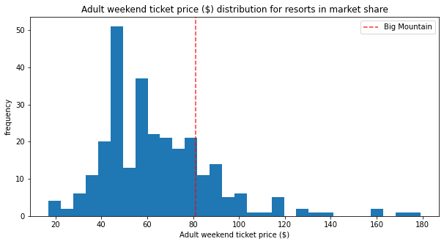
Comparing Big Mountain Resort current pricing
In comparison to other resorts, Big Mountain is not the most expensive but is entering the higher end of the main distribution of pricing.

Slide 7
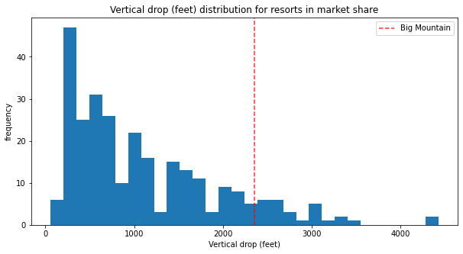
Vertical Drop
The vertical drop is above the average and definitley on the higher side but there are still some other resorts with a larger vertical drop.

Slide 8
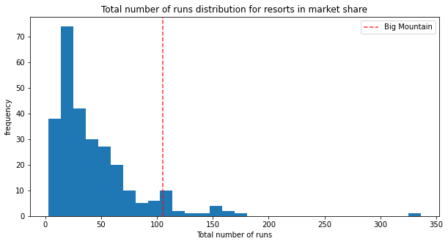
Number of Runs
Big Mountain Resort is at the higher end of number of runs.

Slide 9
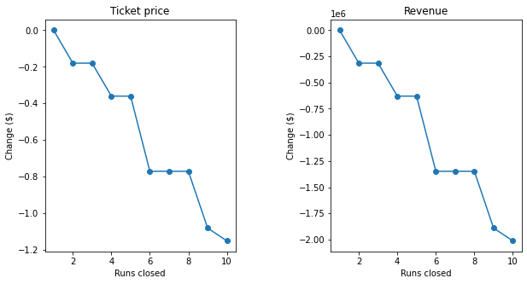
Closing down runs
When considering closing down runs in order to increase prices and revenues. It seems that there is not much difference in closing 2-3 runs but once we make a jump to 4, there would a significant dip in revenge.

Slide 10
Conclusion
In conclusion, Big Mountain resort would need to increase ticket prices to break even after the increased operating costs of adding a new ski lift. Big Mountain was also interested in making sure that they are optimizing their market value of amenities in comparison to how other resorts were pricing their own tickets. Thus leaving Big Mountain with a few more options to change such as closing 2-3 of the least popular lifts to reduce operating costs or increasing the vertical drop.

